Slide 1


NVIDIA INSIGHT ANALYSIS TEAM
John Vincent Deniega
Jeremiah Fa’atiliga
Dip Bista
Gabriel Mancillas Gallardo

Slide 2
OVERVIEW
TEAM
PROBLEM STATEMENT
EXPORATORY DATA ANALYSIS
MODELS AND PERFORMANCE
BUSINESS RECOMMENDATIONS

Slide 3
TEAM
Evelyn Preciado
Jeremiah Fa’atiliga
John Vincent Deniega
Gabriel Mancillas Gallardo
Dip Bista
Zachariah Miller
Joseph Talles

Slide 4
PROBLEM STATEMENT
Investors - both retail and institutional - and analysts face significant challenges in navigating the volatility and complexity of the stock market. With an immense availability of data it can be overwhelming to wrangle that data to strategically deploy capital into investments that optimize returns while effectively managing risk.
Nvidia Insight Analysis Team’s Solution: to make predictions on the direction and magnitude of Nvidia’s future share price (positive or negative) as well as explore the efficacy of the magnitude of prediction utilizing regression modeling.

Slide 5
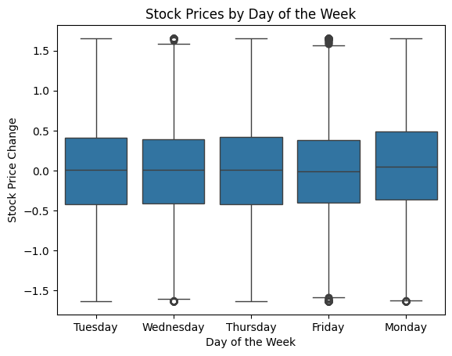
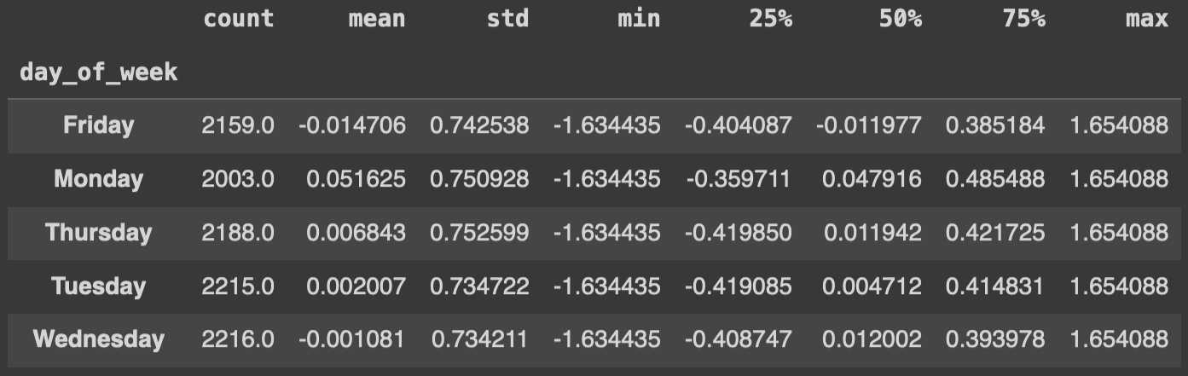
EXPLORATORY DATA ANALYSIS: Day of Week
Buy? Fridays have central tendencies (mean and median) of negative price changes.
Sell? Monday central tendencies (mean and median) are the most positive of any day.
Standard Deviation are relatively consistent throughout.

Slide 6

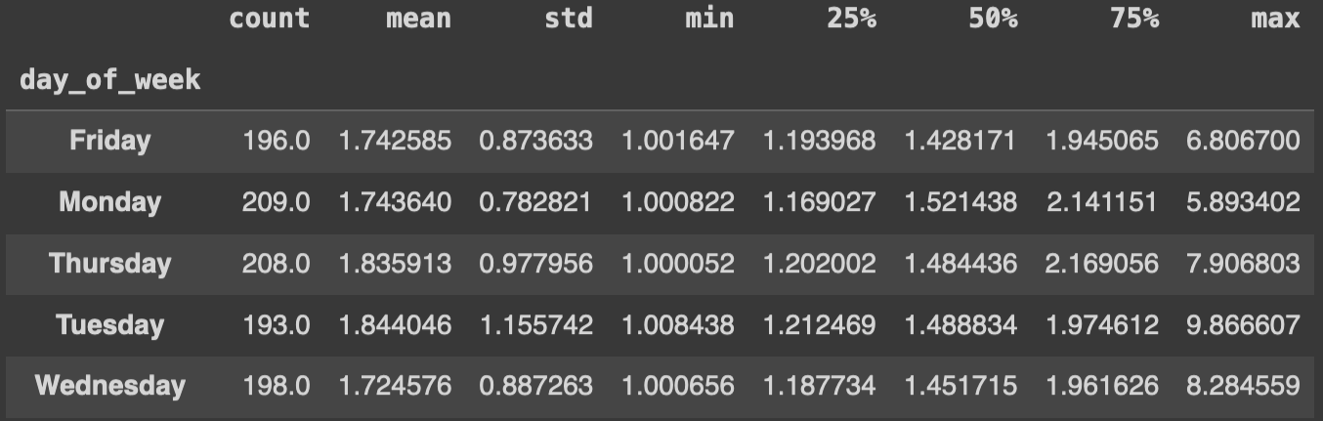
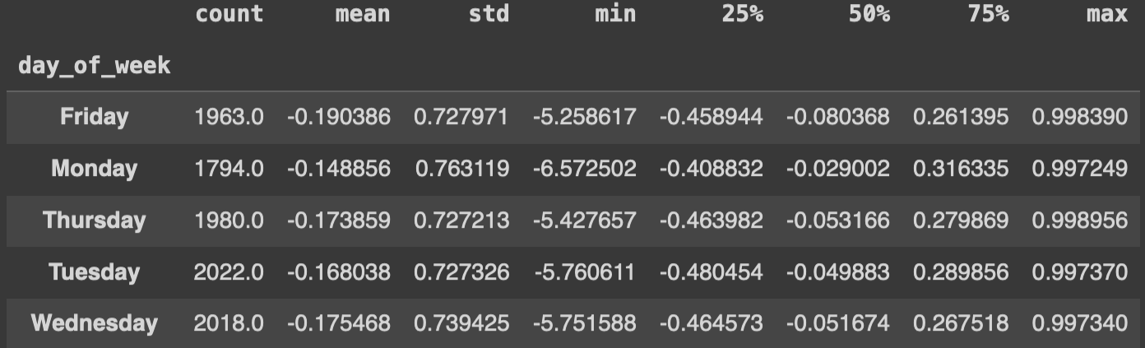
EDA: When volatile
Hours with >1% price increase
When volatile, shares tend to fall 10 times more frequently than rise
Monday is the most likely to rise given high volatility.
Tuesday is most likely to fall given high volatility
Hours with >1% price decrease

Slide 7
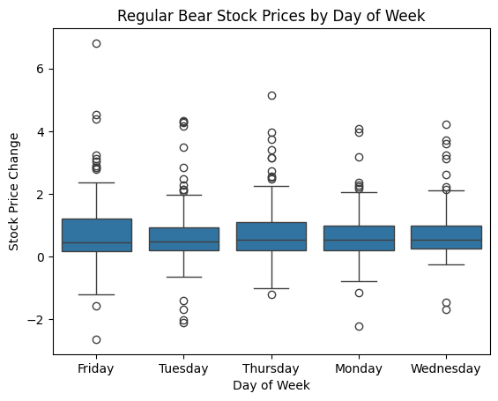
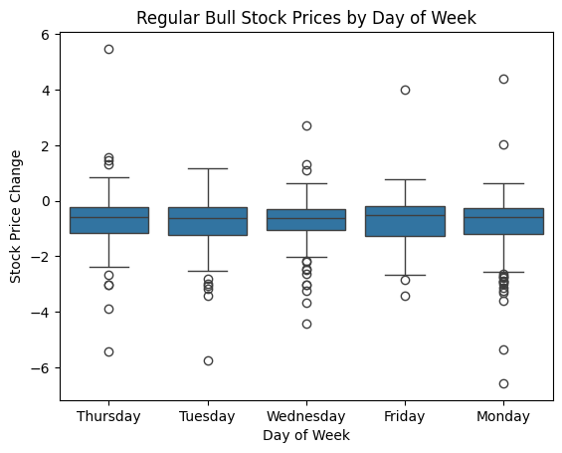
EDA: Relative Strength Index Bearish vs. Bullish Signals
Bearish signals tend to have positive mean and median
Outlier values on volatility tend to skew positively
Fridays exhibit the widest positive dispersion.
This result matches overall day of the week finding.
Bullish signals tend to have negative mean and median
Outlier values on volatility tend to skew negatively.
Mondays exhibit the widest negative dispersion.
This result matches overall day of the week finding.

Slide 8
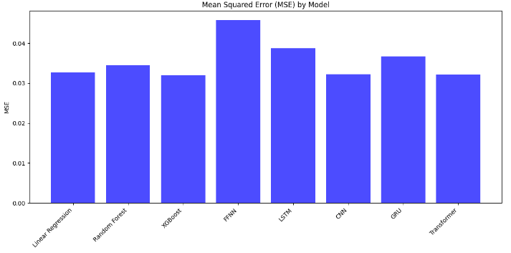
MODELS AND PERFORMANCE

Slide 9
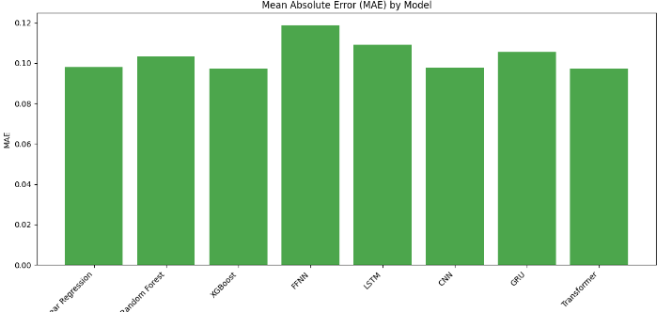
MODELS AND PREFORMANCE

Slide 10
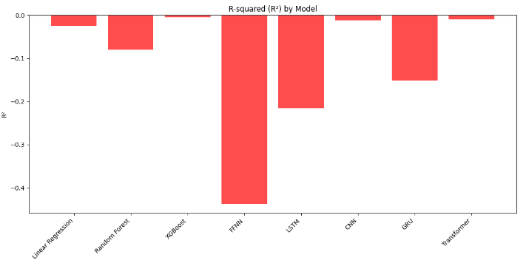
MODELS AND PREFORMANCE

Slide 11
BUSINESS RECOMENDATIONS
Based on hourly data across over 10,000 records:
The most probable market price “top” is on Friday: BUY
The most probable market price ”bottom” is on Monday: SELL
When market is volatile, 10-to-1 odds the trading period is negative
Action: Watch this period, then buy (likely on a Friday) when price normalizes
Utilize further iteration so XGBoost algorithm to refine regression performance hyperparameters and monitor for model drift.

Slide 12
THANK YOU
JEREMIAH FA’ATILIGA
jfaatiliga@sandiego.edu
DIP BISTA
dbista@sandiego.edu
JOHN VINCENT DENIEGA
jdeniega@sandiego.edu
GABRIEL MANCILLAS GALLARDO
gmancillasgallardo@sandiego.edu

